Slide 1
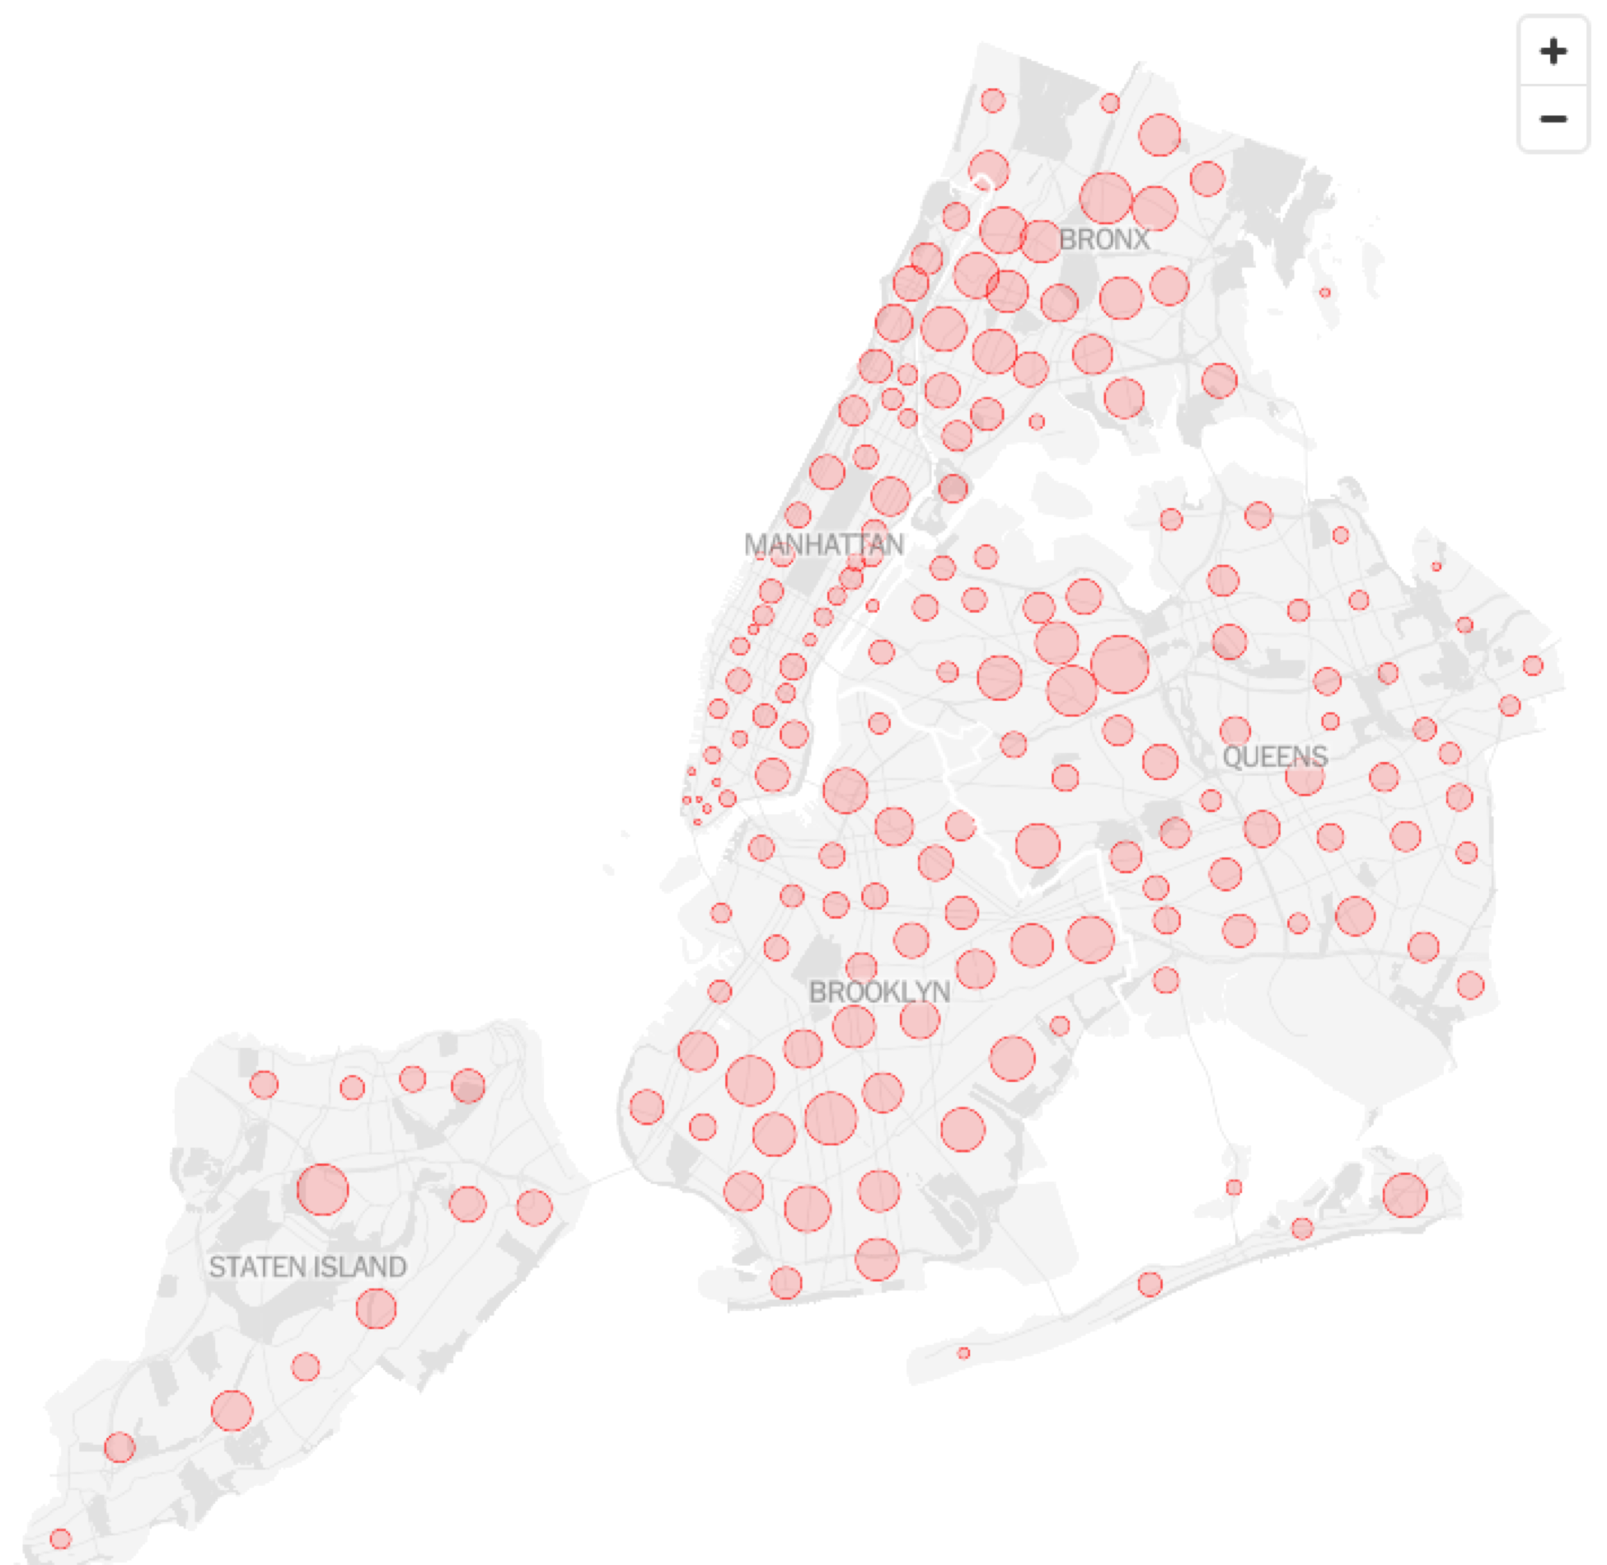
Capstone Project: The Battle of Neighborhoods
What are the common features of areas with high COVID case rate in New York?

Slide 2
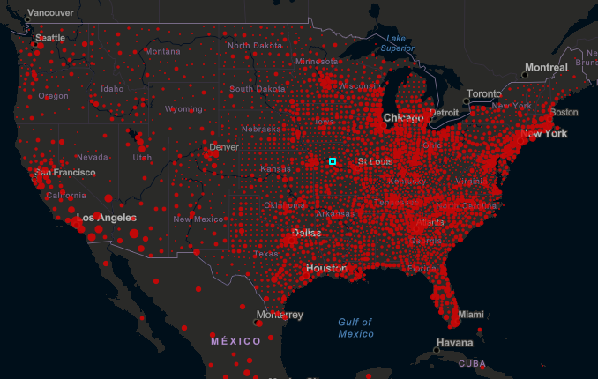
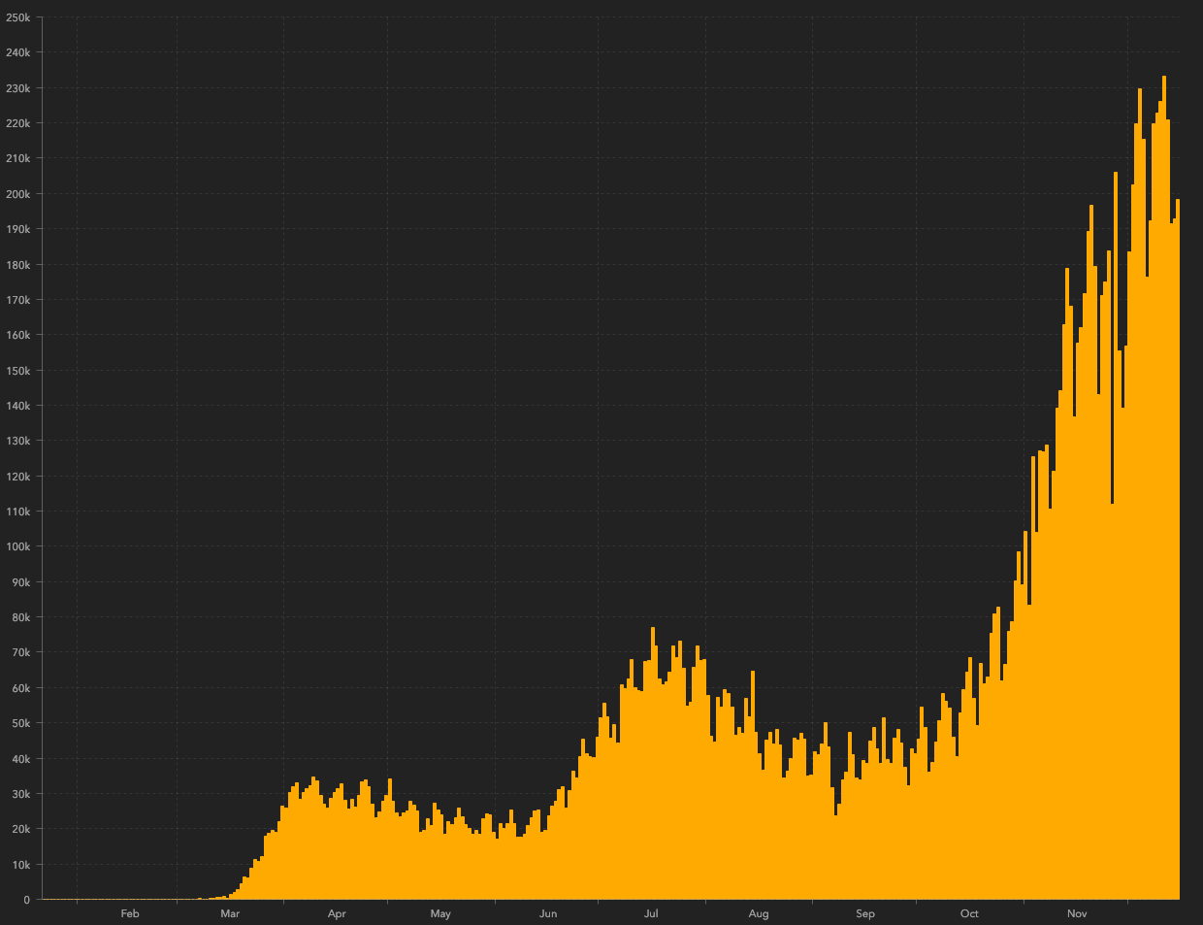
Introduction
The World Health Organization declared that COVID-19 was a global pandemic
Widely spread around the world
US has the highest number of confirmed cases
During this fall and winter time, situation is getting worse again.
https://coronavirus.jhu.edu/map.html

Slide 3
In this capstone project, I did a tiny study to explore the distribution of COVID cases in New York and tried to understand what were the common features of those neighborhoods with relatively high COVID confirmed cases. With the venues data collected from Foursquare, neighborhoods in New York were clustered into 5 groups. The results showed that 70% of the top 20 areas with the highest confirmed case rate were from the same group. And most venues in these areas with the highest amounts were in food-related categories, such as Pizza Place, Deli/Bodega, Restaurant, Bagel Shop, Ice Cream Shop, Grocery Store, Bakery, and Coffee Shop. The result suggests that we need to take extra caution when we have to visit these kinds of places during the pandemic.

Slide 4
Data
COVID data
The COVID case data of New York come from NYC Health. The data contains cumulative totals since the start of the COVID-19 outbreak in New York City.
The data used in this study were grouped by Modified Zip Code Tabulation Areas (MODIFIED_ZCTA).
Geographical coordinate
The latitude and longitude for each MODIFIED_ZCTA are collected from GeoPy using geocoders.nominatim.
Venue dat
Venue data are collected from Foursquare. Due to the limitation of requests that can be made, only 100 venues are collected for each MODIFIED_ZCTA with a radius of 1000m.

Slide 5
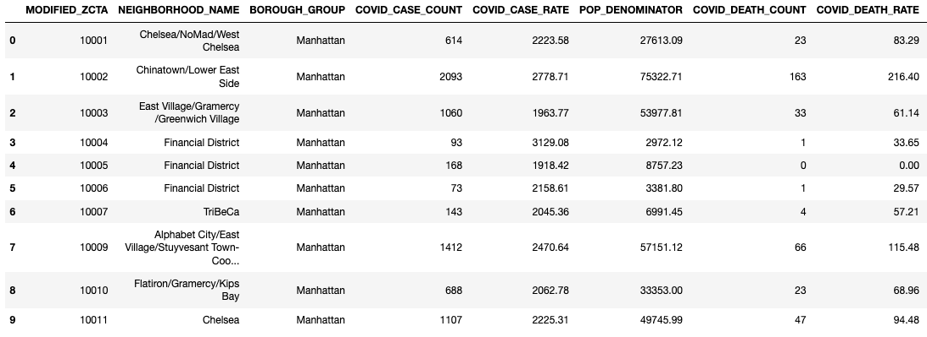
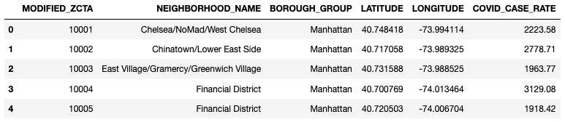
Data processing

Slide 6
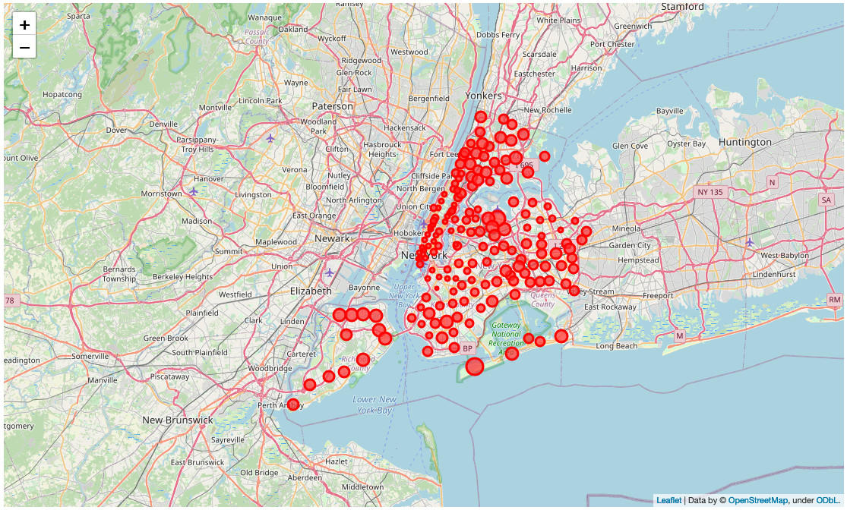
Visualization of the COVID data

Slide 7
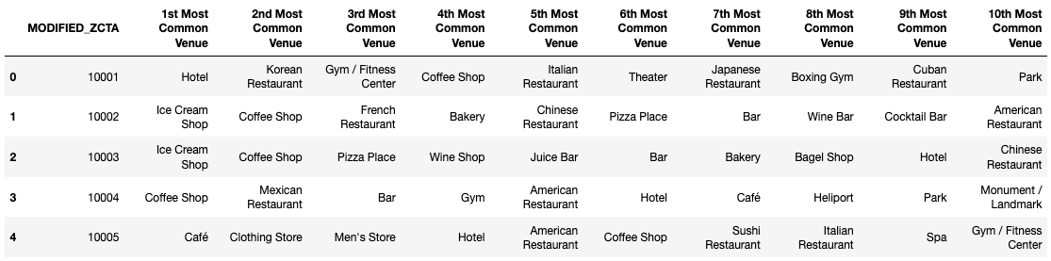
Collect Venus information for each area
To cluster these 177 neighborhoods, venue information is collected for each MODIFIED_ZCTA from Foursquare.

Slide 8
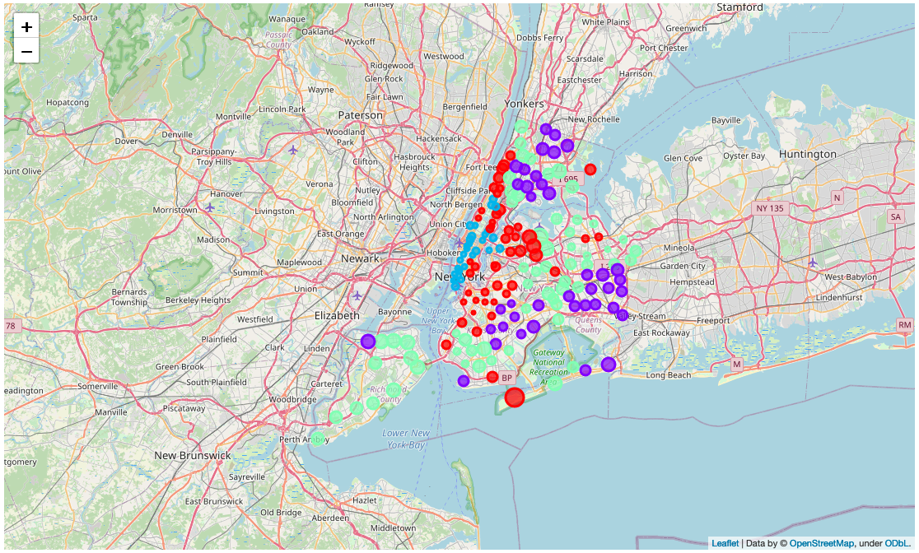
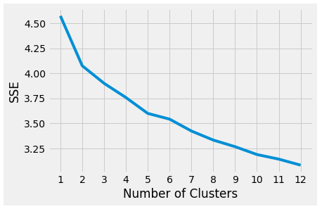
Clustering using k-means methods

Slide 9
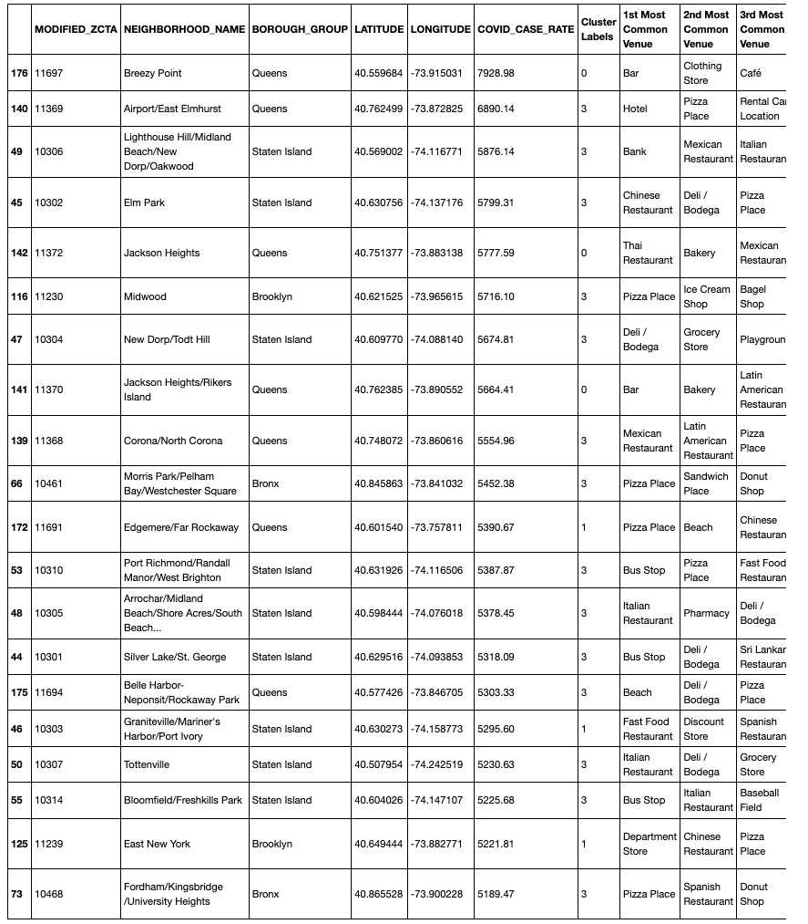
Most common venues in high COVID-rate areas
70% of the top 20 areas are labeled as cluster 3, which means those areas suffered from high COVID case rates do share some common features.
Most of these features are related with food.

Slide 10
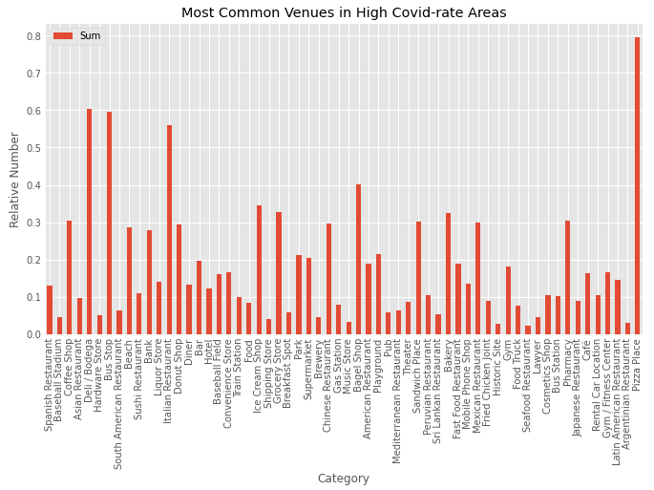
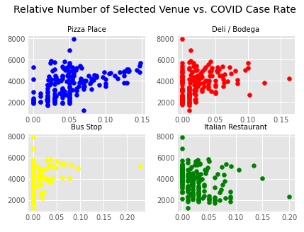
Most common venues in high COVID-rate areas

Slide 11
Summaries
most of the MODIFIED_ZCTAs with high COVID case rates are clustered into same groups (Cluster 3)
70% of the top 20 most common venues in these 14 areas (cluster 3) are in food-related categories
Pizza Place, Deli/Bodega, Bus Stop, and Italian Restaurant have much larger relative amount than other categories in these areas.
that there is a strong positive relationship between Pizza Place and COVID case rate among all 177 areas.

Slide 12
References
[1] https://www.who.int/emergencies/diseases/novel-coronavirus-2019
[2] https://www.ncbi.nlm.nih.gov/pmc/articles/PMC7205668/
[3] https://www1.nyc.gov/site/doh/covid/covid-19-data.page
[4] https://github.com/nychealth/coronavirus-data

